Slide 1
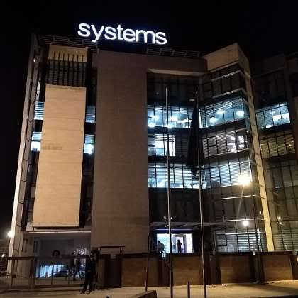


FINAL INTERNSHIP VIVA
Front-End Web
Development Internship
Systems Limited • KSA Digital Consulting
Muhammad Ahmad
Roll No: 2023-BS-CS-295
BS Computer Science
The University of Faisalabad
21 July – 13 August 2025

Slide 2
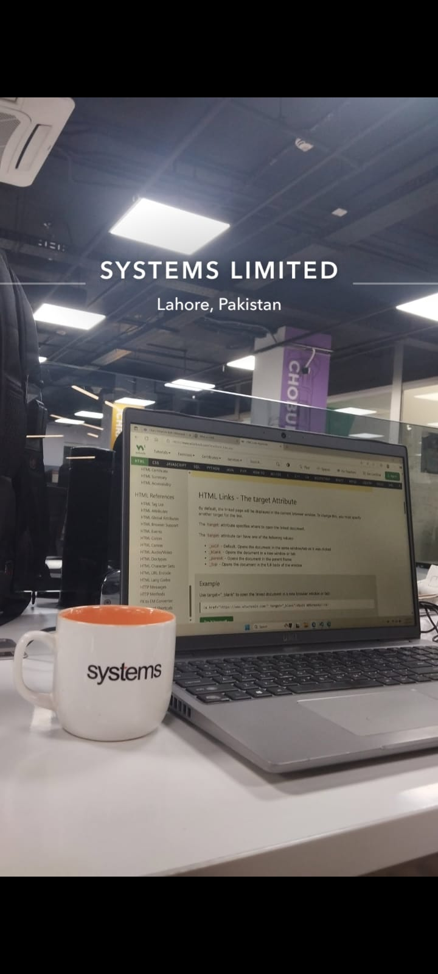
INTERNSHIP VIVA PRESENTATION
Internship Snapshot
A quick overview of the placement, documents, and technical scope.
STUDENT
HOST ORGANIZATION
DURATION
Muhammad Ahmad
2023-BS-CS-295
BS Computer Science
Systems Limited
KSA Digital Consulting
Front-End Internship
21 July – 13 August 2025
Completion certificate
Viva: final internship
WHAT THIS INTERNSHIP WAS ABOUT
A focused front-end learning experience
Main focus: HTML and CSS fundamentals
Basic JavaScript for simple user interaction
Responsive layouts and cross-screen testing
HTML learning at the workplace
Debugging, code organization, and professional workflow
No backend, database, API, or advanced framework work
Systems Limited • Front-End Web Development

Slide 3
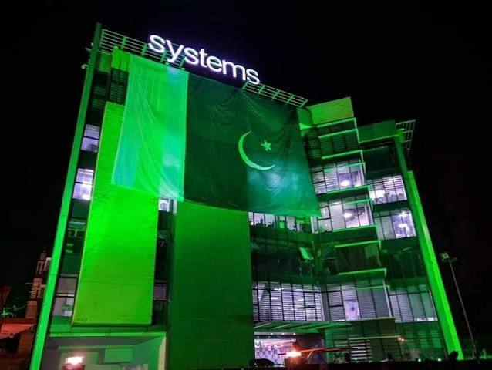
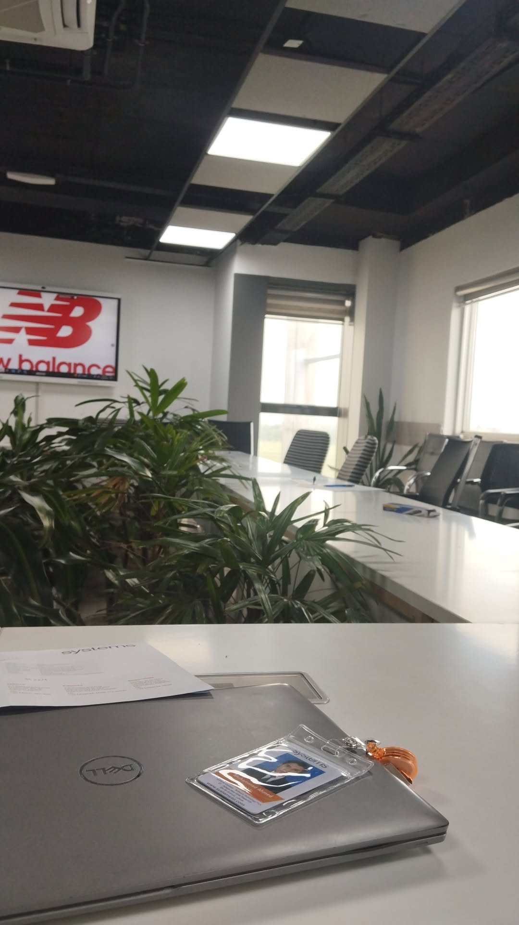
INTERNSHIP VIVA PRESENTATION
About Systems Limited
Host organization and professional work context.
COMPANY OVERVIEW
1
Systems Limited is a leading Pakistan-based technology and digital transformation company.
2
It delivers software engineering, cloud, data, enterprise applications, consulting, and managed services.
3
The company serves clients across multiple industries and international markets.
Systems Limited office
4
Its teams work through structured software-development processes, modern tools, and collaborative workflows.
5
Systems Limited emphasizes innovation, quality, customer-focused delivery, and continuous professional learning.
6
My internship exposure was within the KSA Digital Consulting context, where I observed professional software practices.
Professional workplace environment
KSA DIGITAL CONSULTING
Host Organization • Systems Limited

Slide 4
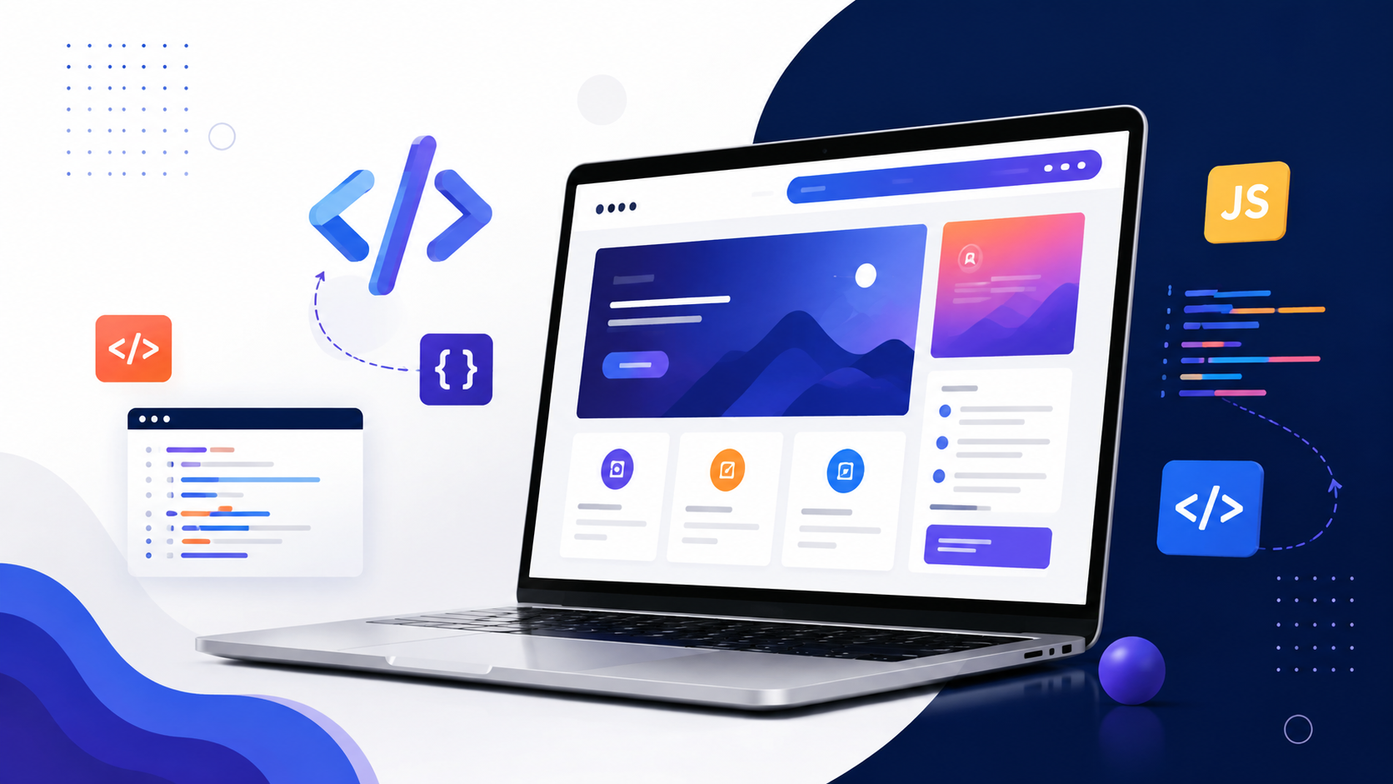
OFFICIAL WEBSITE RESEARCH
Systems Limited at a Glance
Official website research converted into viva-friendly company context.
49+
8500+
16+
300+
years of continual excellence
change makers driving transformation
countries with presence and clientele
active clients across the globe
WHAT SYSTEMS DOES
WHY IT MATTERS FOR MY INTERNSHIP
AI transformation and modern digital consulting
Professional exposure to a large technology organization
Data & analytics, cloud, security, and infrastructure
Real awareness of structured software development practices
Business applications, digital commerce, and BPS
Clear link between front-end skills and digital solutions
Solutions for banking, communications, public sector, health, retail, automotive, and hospitality
Motivation to strengthen fundamentals before advanced frameworks
Sources: Systems Limited official website — homepage, company overview, services, and careers pages.
Official Website Research • Systems Limited

Slide 5
INTERNSHIP VIVA PRESENTATION
Company Philosophy & Values
A professional environment based on innovation, integrity, and continuous improvement.
OFFICIAL WEBSITE INSIGHT
Systems Limited describes its approach as continued self-reinvention, investment in next-generation capabilities, specialized talent, and sustainable value creation.
1
Integrity
Dependability, honesty, and transparency
Systems Limited exterior
2
Innovation
Experimenting and making bold decisions
3
Dedication
Delivering precision and perfection
Learning HTML at Systems
My takeaway: good front-end work requires the same values — clean structure, creative design, and careful delivery.
Company Philosophy • Official Website Research

Slide 6
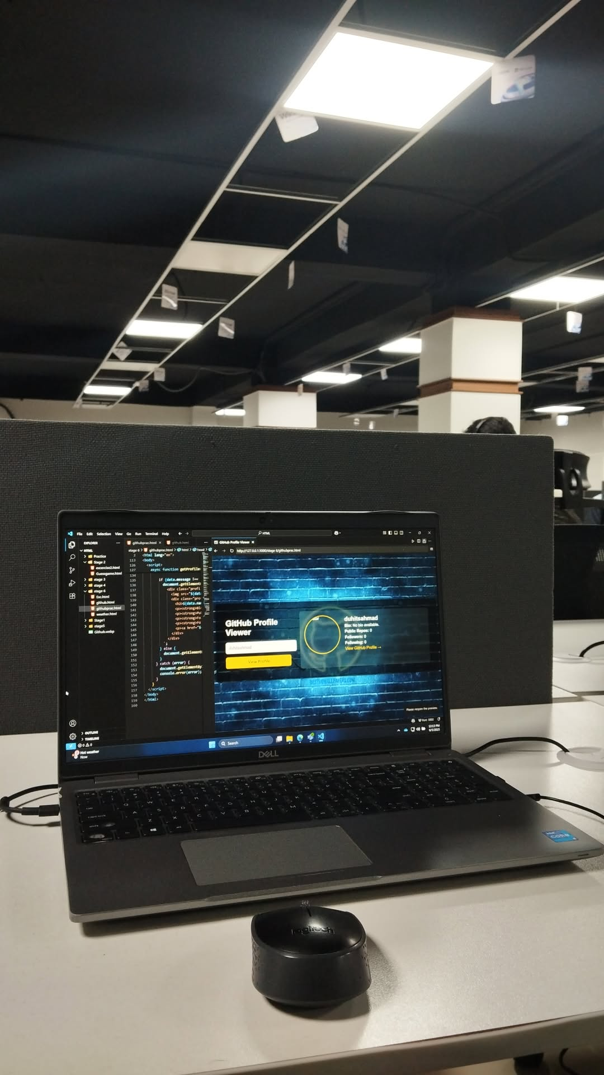
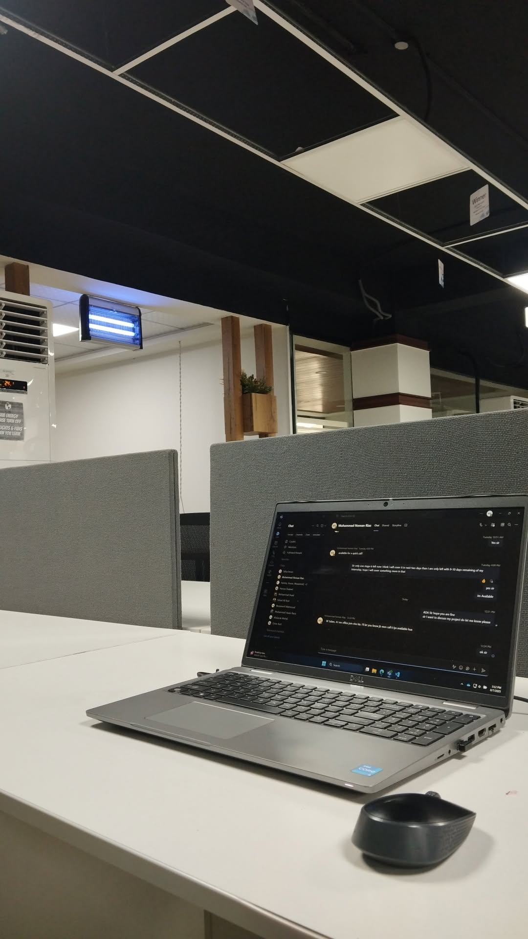
INTERNSHIP EXPERIENCE
My Internship Environment
A glimpse of the office, learning setup, communication, and practice work.
HTML learning
Systems Limited
Workplace / meeting environment
Communication & coordination
Front-end practice in VS Code
Office exterior
Internship Photo Highlights

Slide 7
INTERNSHIP VIVA PRESENTATION
Internship Purpose & Objectives
The internship converted classroom knowledge into practical front-end development ability.
✓
Technical Objective
✓
Professional Objective
✓
Academic Objective
Build a clear foundation in HTML, CSS, responsive layouts, and basic JavaScript interaction.
Improve communication, feedback handling, time management, problem solving, and quality review.
Connect BS Computer Science concepts with real workplace tasks, tools, and development practices.
KEY OBJECTIVES
Understand the structure of a complete web page using semantic HTML.
Design visually consistent interfaces using CSS and modern layout techniques.
Make pages usable on laptop, tablet, and mobile screen sizes.
Use JavaScript only for simple DOM interaction and basic input checks.
Practice browser-based debugging, testing, and iterative correction.
Learn how professional feedback and task discipline improve software quality.
Purpose & Objectives

Slide 8
INTERNSHIP VIVA PRESENTATION
Technical Scope: Front-End Only
My internship scope was intentionally focused on strong fundamentals.
HTML
CSS
RESPONSIVE
BASIC JS
Included
HTML structure, semantic sections, links, images, lists, tables and forms
CSS selectors, box model, typography, spacing, Flexbox and Grid
Responsive layouts, flexible widths and media queries
Basic JavaScript: variables, functions, DOM selection, clicks and simple checks
Browser testing, developer tools, debugging and code organization
Not included
Backend development • Databases • APIs • Server configuration • Advanced JavaScript frameworks
Technical Scope

Slide 9
INTERNSHIP VIVA PRESENTATION
Front-End Development Workflow
I followed a clear step-by-step method from requirement to final review.
1
Requirement
2
HTML
3
CSS
4
Responsive
5
JavaScript
6
Debug
Understand the page goal
Build the structure
Style the layout
Test screen sizes
Add simple interaction
Fix and polish
Why this sequence worked
Main lesson
Clean HTML made styling easier
Complete one layer, test it, then move to the next.
CSS was completed before interaction
Responsive issues were fixed before final polish
Coordination & task communication
Development Workflow

Slide 10
INTERNSHIP VIVA PRESENTATION
HTML: Page Structure & Semantics
HTML formed the base layer of my front-end practice.
WHAT I PRACTICED
Document skeleton: html, head, title, metadata and body
Semantic sections: header, nav, main, section and footer
Content elements: headings, paragraphs, lists, links, images and tables
Form basics: labels, inputs, buttons, text areas and simple structure
File linking: stylesheet, JavaScript and image paths
Logical nesting and readable page organization
SEMANTIC STRUCTURE
<header> <nav>...</nav> </header>
<main> <section>...</section> </main>
<footer> contact / links </footer>
Learning and practicing HTML at Systems Limited
HTML Fundamentals

Slide 11
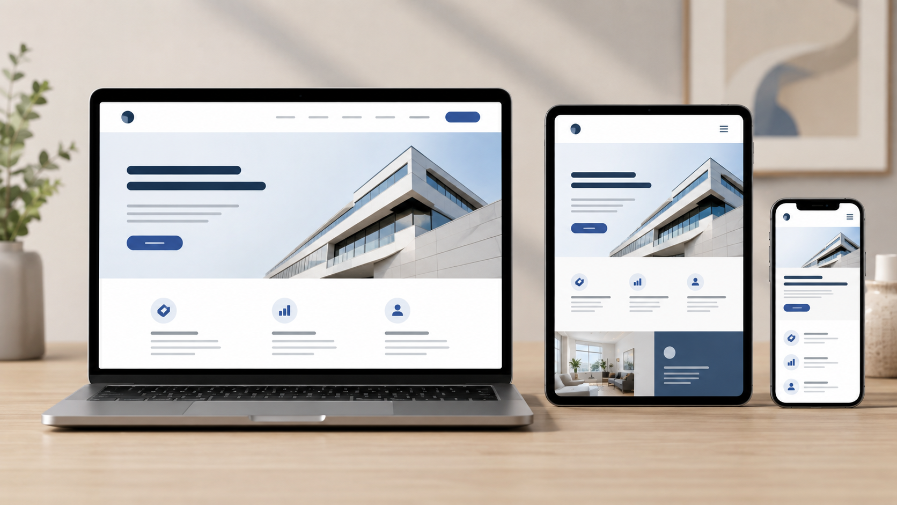
INTERNSHIP VIVA PRESENTATION
CSS: Styling, Layout & Visual Consistency
CSS formed the largest part of my internship work.
Selectors
element, class, ID, descendant, pseudo-class
Box Model
content, padding, border, margin
Typography
font size, line-height, spacing
Layout
Flexbox, Grid, gaps, alignment
Reusable CSS
shared classes and consistent visual rules
Polish
buttons, cards, backgrounds, hover states
Key improvement
I learned to choose the right CSS property for the visual problem instead of using random margins.
CSS & Visual Design

Slide 12
INTERNSHIP VIVA PRESENTATION
Responsive Design Practice
A web page should remain usable and readable across different screen sizes.
DESKTOP → TABLET → MOBILE
Avoided unnecessary fixed widths
Used flexible containers and scalable images
Applied media queries for smaller screens
Checked navigation, cards, forms and text wrapping
Fixed overflow, horizontal scrolling and uneven spacing
Responsive habit: I resized and tested the page throughout development instead of waiting until the end.
Responsive Web Design

Slide 13
INTERNSHIP VIVA PRESENTATION
JavaScript: Basic Interaction Only
JavaScript was introduced at beginner level to make static pages respond to simple user actions.
BASIC DOM INTERACTION
Concepts practiced
const button = document.querySelector("#menuBtn");
button.addEventListener("click", () => {
Variables and simple functions
menu.classList.toggle("open");
Conditions and basic logic
});
DOM element selection
// simple interaction, no complex framework
Event listeners and button clicks
Show/hide or menu-toggle behavior
Simple form/input checks
User clicks
Event listener
Function runs
Page updates
Scope limit: no advanced framework, backend connection, database, or complex application logic.
Basic JavaScript

Slide 14
INTERNSHIP VIVA PRESENTATION
Front-End Practice Project
I combined HTML, CSS, and basic JavaScript into a small responsive website layout.
PROJECT COMPONENTS
Header and navigation area
Hero / introductory section
Information or service cards
Content sections with text and images
Contact or input form
Footer and simple interactive behavior
Integration value
The project showed how structure, styling, responsiveness, and interaction work together as one front-end experience.
Front-end practice in Visual Studio Code
Front-End Practice Project

Slide 15
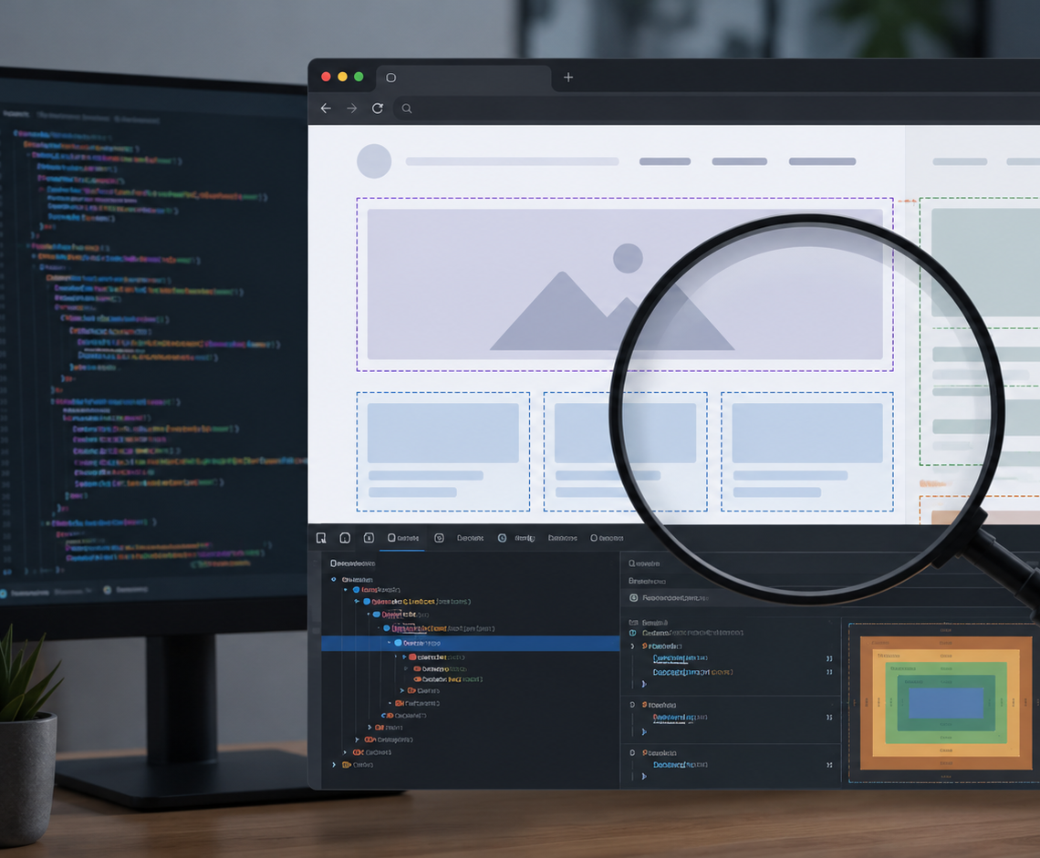
INTERNSHIP VIVA PRESENTATION
Testing, Debugging & Quality Review
Quality review was a regular part of my internship workflow.
DEBUGGING CHECKLIST
Checked broken links and image paths
Corrected missing tags and wrong nesting
Inspected CSS rules through browser developer tools
Adjusted margins, padding, widths, gaps and alignment
Tested forms, buttons, and basic JavaScript behavior
Reviewed layouts at different screen sizes
Debugging lesson: isolate one issue, test it, correct it, then move to the next.
Testing & Debugging

Slide 16
INTERNSHIP VIVA PRESENTATION
Challenges Faced & How I Solved Them
Repeated correction and feedback improved my problem-solving approach.
1
Layout mismatch
Used Flexbox/Grid instead of random margins
2
Mobile overflow
Used flexible widths and media queries
3
CSS not applying
Checked selectors, links, and rule priority
4
Image not loading
Corrected relative paths and file organization
5
JS interaction failing
Checked element selection and event listener
Overall improvement: understand the issue → inspect the code → test one change → confirm the result.
Challenges & Problem Solving

Slide 17
INTERNSHIP VIVA PRESENTATION
Learning Outcomes: Theory to Practice
The internship connected university concepts with real front-end tasks.
1
2
3
4
5
Web Technologies
Programming Logic
HCI / UI Thinking
Software Engineering
Professional Practice
HTML/CSS structure, styling and responsive behavior
Basic JavaScript events, functions and conditions
Readable layouts, navigation, forms and screen-size usability
Task breakdown, iteration, testing and maintainability
Feedback, communication, discipline and review
KEY OUTCOMES
Stronger HTML confidence
Main technical outcome
Better CSS layout judgment
Strong front-end fundamentals
Improved responsive-design awareness
HTML + CSS became my strongest areas; JavaScript provided a useful beginner foundation for future learning.
Basic JavaScript foundation
More systematic debugging
Greater workplace discipline and communication
Learning Outcomes

Slide 18
INTERNSHIP VIVA PRESENTATION
Professional Growth & Reflections
The internship improved my work habits in addition to technical skills.
Clear communication with supervisors and team members
Positive response to feedback and corrections
Better time management through staged work
Communication & coordination
Greater attention to detail in UI consistency
REFLECTION
More patience while debugging and revising code
Strong basics and a professional attitude are both necessary for growth in software development.
Understanding of workplace discipline and software process
Workplace environment
Professional Growth

Slide 19
INTERNSHIP VIVA PRESENTATION
Recommendations
Suggestions for future front-end internship programs and continued learning.
Use a weekly front-end learning roadmap
Start with HTML, move into CSS, responsive design, then basic JavaScript.
1
Add short code-review sessions
Review HTML structure, CSS quality, naming, responsiveness, and readability.
2
Use a responsive-design checklist
Check navigation, forms, images, cards, overflow, and spacing before final submission.
3
Introduce JavaScript gradually
Build strong HTML/CSS fundamentals before moving toward advanced JavaScript.
4
Maintain a small portfolio
Keep a responsive landing page, form interface, card layout, and interactive page as evidence of progress.
5
Recommended sequence → HTML → CSS → Responsive Design → Basic JavaScript
Recommendations

Slide 20
CONCLUSION
What I gained from
this internship
HTML and CSS became my strongest technical areas
Basic JavaScript gave me a starting point for interaction
I learned how to test, debug, and improve responsive web pages
I improved communication, feedback handling, and task discipline
The experience created a stronger base for future front-end projects
Strong fundamentals first. Advanced tools next.
Thank you

Slide 21
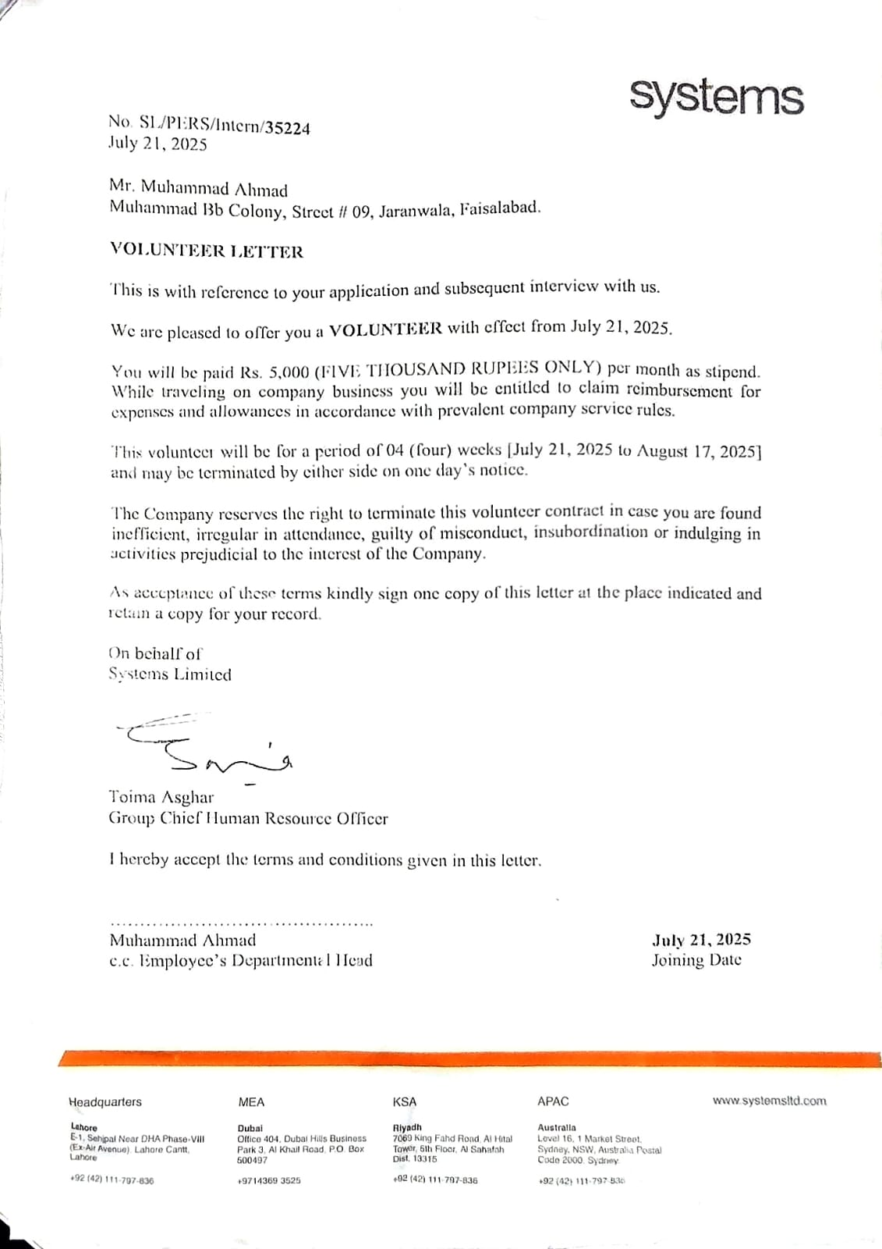
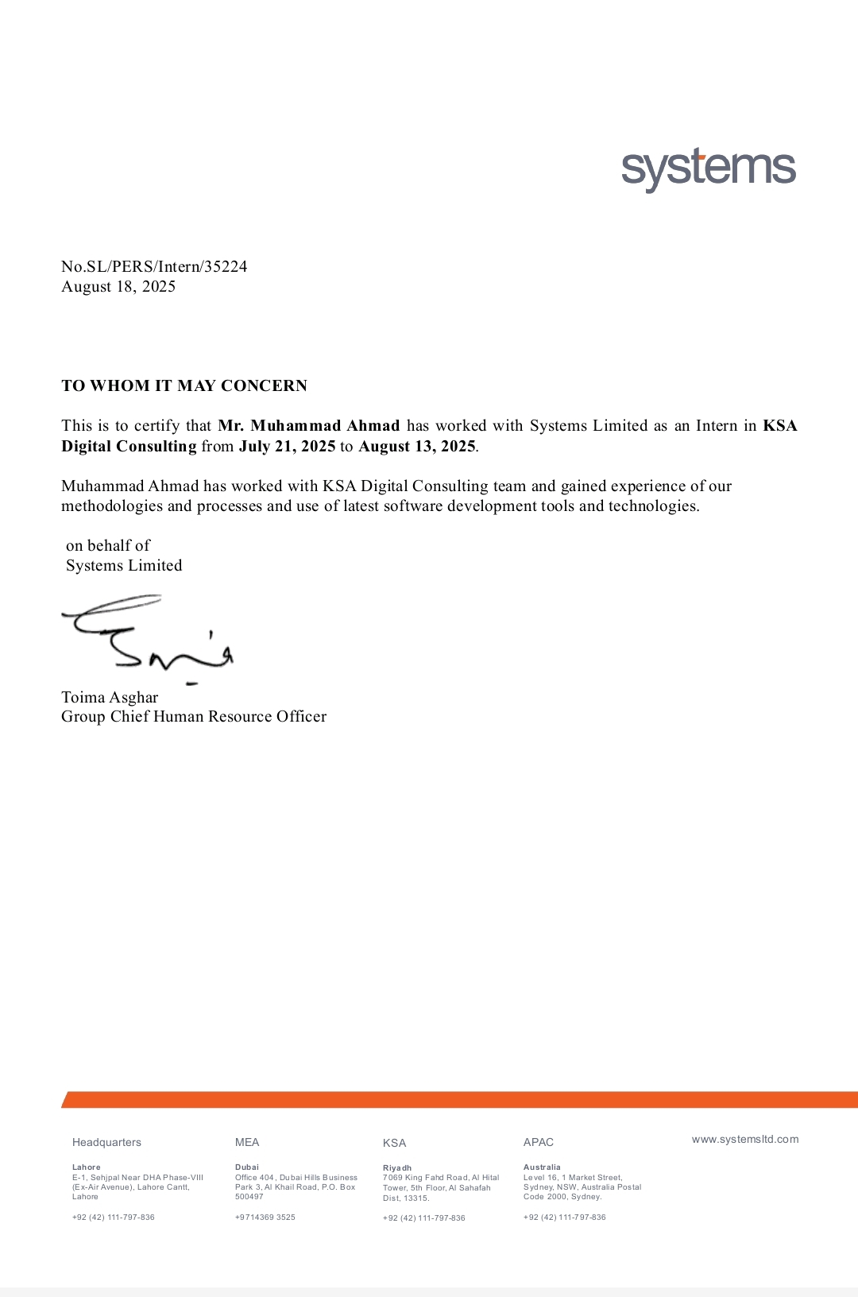
INTERNSHIP VIVA PRESENTATION
Supporting Documents & Viva Readiness
The final viva requires presentation slides and supporting internship documentation.
VIVA CHECKLIST
Final internship presentation slides
Simple printed copy of internship report for viva
Offer letter and completion certificate attached in report
Prepared to explain tasks, learning outcomes, challenges, and recommendations
Technical focus clearly limited to front-end: mostly HTML/CSS + basic JavaScript
Ready for final internship viva
Internship Offer Letter
Internship Completion Certificate
Supporting Documents

Slide 22
SOURCES
Research Sources
Company facts were verified from the official Systems Limited website and internship instructions.
WEBSITE SOURCES USED
Systems Limited official homepage: company positioning, services, statistics, industries, and featured insights.
Systems Limited company overview page: philosophy, core values, accomplishments, leadership, and global presence.
Systems Limited services page: AI transformation, digital, data analytics, cloud, security, infrastructure, and BPS offerings.
Systems Limited careers page: people culture, internship/MTO track, global presence, and professional learning environment.
University internship instruction file: viva requirement for presentation slides and internship report copy.
Presentation content remains limited to the actual internship scope: HTML, CSS, responsive front-end design, and basic JavaScript.
References and Source Verification

